Slide 1
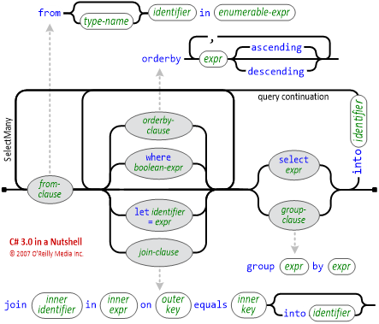
Week 3: LINQ Queries
LINQ Queries

Slide 2
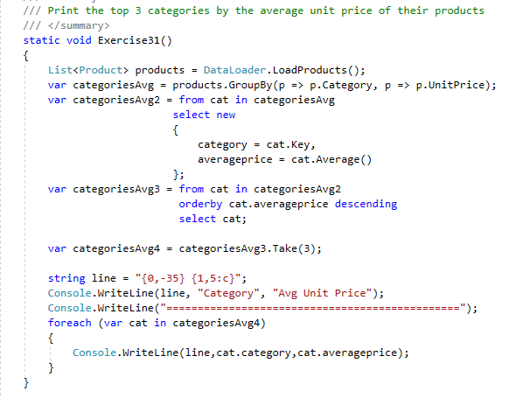
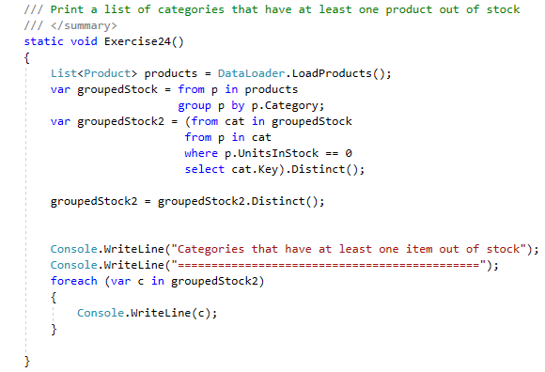
Grouped all unit prices by category.
Selected only the category with the associated unit price avg.
Ordered those results by unit price in descending order.
Took 3, which should be the greatest three.
Grouped products by category (hindsight, not sure why I didn’t group unitStock by category.
Narrowed results to only ones ones where unitStock is 0.
This could still include multiples in one category though, so Distinct() is used to eliminate repeats.

